Slide 1
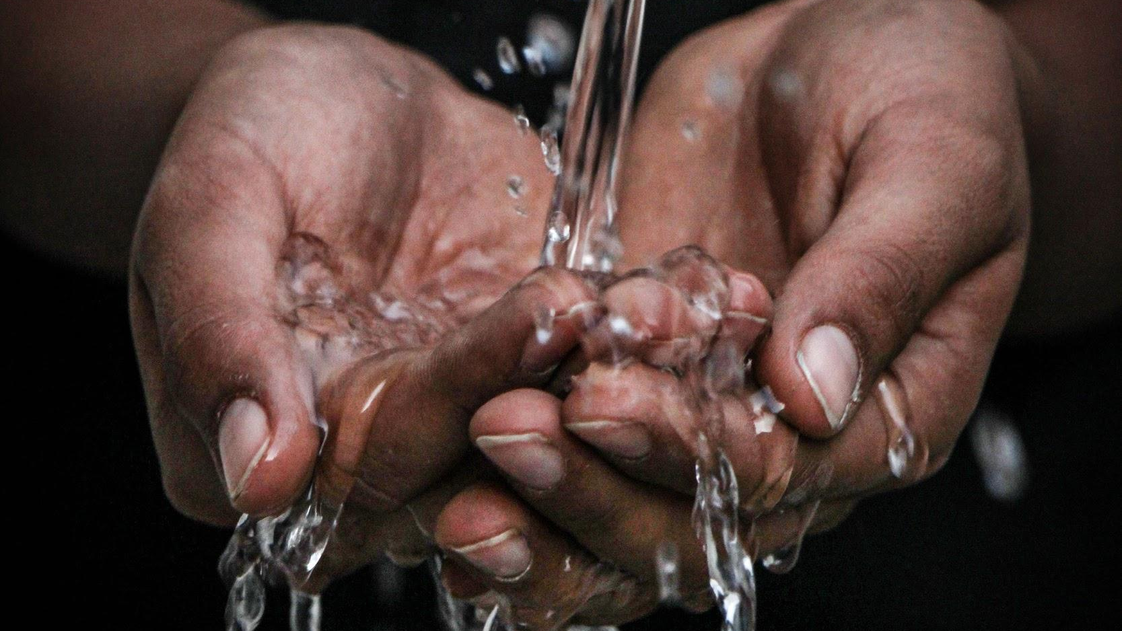
WESTERN AUSTRALIA’S MANAGEMENT OF WATER
We will analyse Western Australia's management of water.
Notes:
Insert cover image and use transparency settings to fade image.

Slide 2
Do not delete this slide.
This slide is designed so that you can copy the prompt box you need and insert it into your slides.
This slide is hidden and will not be included when presenting your lesson.
TRACK WITH ME
VOCABULARY
1 -
HINT
Students, remember….
CHECK FOR UNDERSTANDING
READ WITH ME
TEACHER CUE
MAKE THE CONNECTION
Students, you already know….
EXTENSION
GESTURE WITH ME

Slide 3
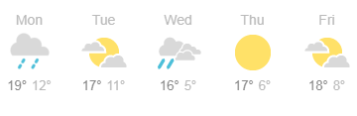
In the weather forecast, what day would have the highest amount of evaporation?
Explain your answer.
Natural Factor | Impact on the water cycle
High sunshine | Increases evaporation of ocean water. Increases evaporation of freshwater. Increases transpiration of plants.
Low sunshine | Increases cloud formation (condensation). Increases rainfall (precipitation).

Slide 4
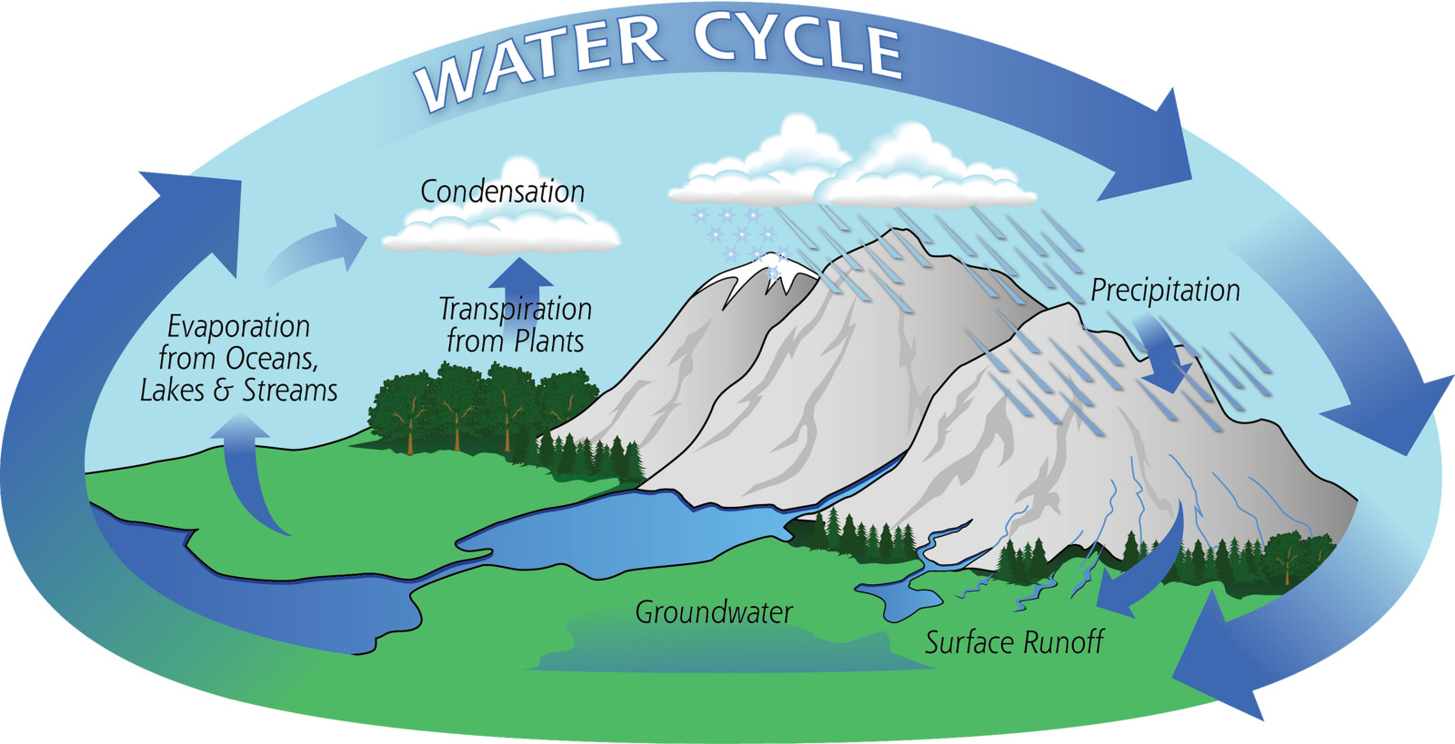
What increases evaporation?
The amount of rain
The ground temperature
Amount of sunlight

Slide 5
Repeat the opposite word/phrase.
RENEWABLE RESOURCE
IT WILL NOT RUN OUT

Slide 6
Repeat the opposite word/phrase.
NON-RENEWABLE RESOURCE
IT WILL RUN OUT

Slide 7
Repeat the opposite word/phrase.
FUEL
MATERIALS BURNT FOR ENERGY

Slide 8
Repeat the opposite word/phrase.
PRECIPITATION
LIQUID WATER AS RAIN

Slide 9
Repeat the opposite word/phrase.
CONDENSATION
WATER VAPOUR INTO DROPLETS

Slide 10
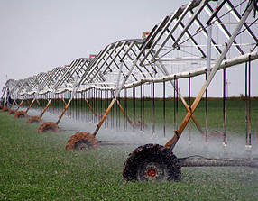
If agricultural water demand decreases what would be a positive impact on the water cycle?
Human Factor | Impact on the water cycle
Agricultural use of water Growing food Farming animals Growing grapes for wine in Margaret River | Increase demand for dam water storage Decrease water available in groundwater Decreases water available to native plants Decreases water in lakes, steams and rivers

Slide 11
What is collection?
Water from oceans, lakes and rivers as a gas.
Plants lose water as gas through their leaves.
Water collects into the ground or runs off to rivers

Slide 12
We will analyse Western Australia's management of water.
TRACK WITH ME
READ WITH ME
We will discuss the issues relating to water use in Western Australia.
We will consider water use in farming, households and gardening.
DECLARE THE OBJECTIVE
Read the learning objective to your partner.
Notes:
Learning Objectives contain concepts (nouns, big ideas), skills (verbs, measurable behaviours) and sometimes context (restricting or targeting conditions).
●Example: Students will be able to describe the concept of density and apply it to floating and sinking.
●
Success criteria are specific measurable outcomes that if met mean that the student has met the learning objective.
Examples:
•Students will be able to compare densities of substances using mass and volume.
•Students will be able to identify whether a solid or liquid will float or sink in a liquid based on their densities.

Slide 13
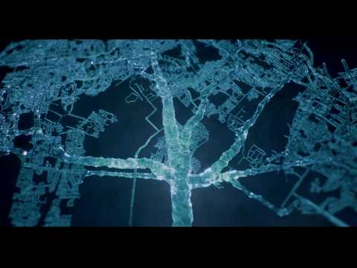
We will analyse Western Australia's management of water.
Humans change the natural movement of water in the water cycle to benefit how we live.
Have you seen any ways that water is wasted?

Slide 14
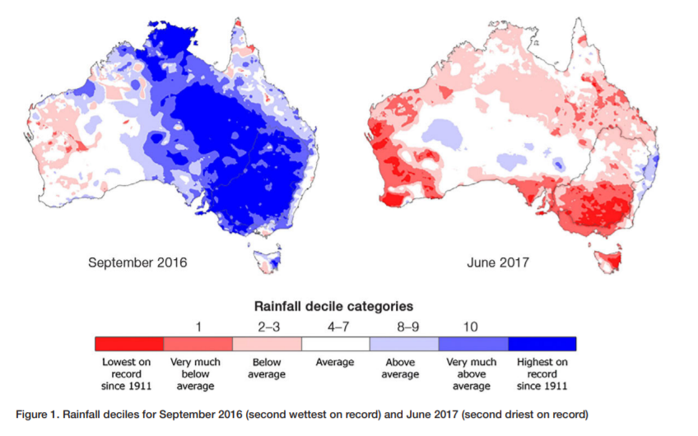
We will analyse Western Australia's management of water.
Western Australia’s water comes from dams₁.
Western Australia (WA) relies on regular rainfall to fill these dams₁.
WA rainfall is decreasing from climate change. WA has experienced the lowest rainfall rate since 1911.
CHECK FOR UNDERSTANDING
Why is decreasing rainfall a problem for WA?
VOCABULARY
1 - man-made pools to store and control water

Slide 15
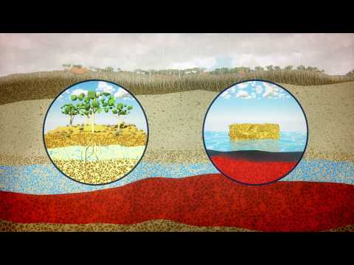
We will analyse Western Australia's management of water.
CHECK FOR UNDERSTANDING
Why does WA supplement dams with other sources?
During warmer months, dams₁ can get low.
WA supplements₂ dams₁ with groundwater and desalinated water.
Desalination is the process of changing seawater into freshwater.
VOCABULARY
1 - man-made pools to store and control water 2 - adds to

Slide 16
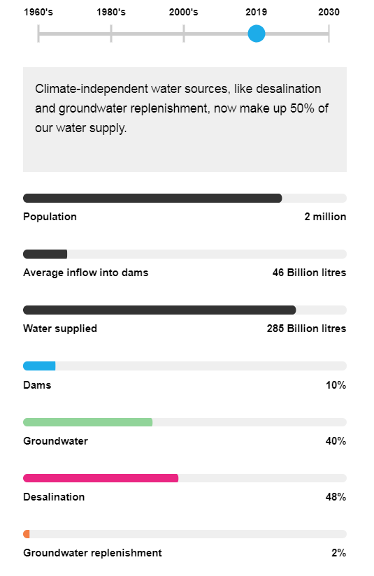
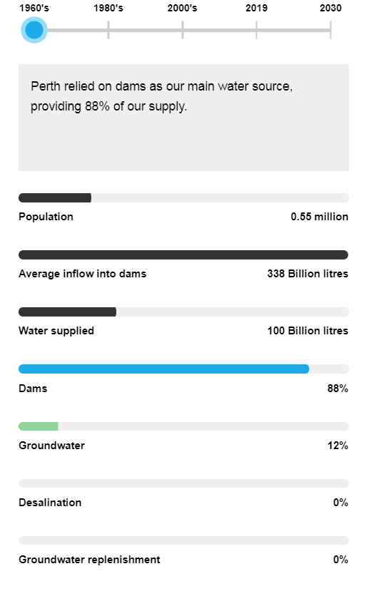
We will analyse Western Australia's management of water.
WA’s population is increasing.
This means more water is needed even with rainfall decreasing.
WA’s water supply sources have changed over time.
CHECK FOR UNDERSTANDING
How has WA’s sources of water changed over time? Why did it need to change?

Slide 17
We will analyse Western Australia's management of water.
CHECK FOR UNDERSTANDING
Describe the impact on WA’s water supply if everyone used water saving practices.
WA uses water in many ways. Lots of water is used for households, gardening and farming.
In WA, some practices waste water. There are water-saving practices which can help reduce waste.
Use | Water Wasting Practices | Water Saving Practices
Household | Long showers Brushing teeth with tap on | Four minute showers Turn tap off while brushing teeth
Gardening | Watering too long or often Watering during the day Plants which need lots of water | Cover soil with mulch or compost Watering at night Native plants
Farming | Crops for livestock Crops which need lots of water | Diet change (reducing meat intake) Crops which don’t need lots of water

Slide 18
We will analyse Western Australia's management of water.
HINT
Climate change has caused a reduction in rainfall for Perth. WA has experienced the lowest rainfall rate since 1911. WA now supplements dams with groundwater and desalination. As our population increases, so does our use of water.
Order the points below into a paragraph.
Low rainfall means less water in dams.
Climate change has decreased WA’s rainfall.
This means water saving practices are important to reduce water usage.
WA now relies on groundwater and desalination to supplement dams.
WA’s population has increased and so water use has also increased.
TEACHER CUE
Please work through as a class.

Slide 19
We will analyse Western Australia's management of water.
The rainfall in Perth has significantly reduced and will continue to do so.
Perth will need to find better ways to manage water as well as find alternative sources of water besides groundwater and dam flow.

Slide 20
We will analyse Western Australia's management of water.
Describe why Western Australians need to use water saving practices.
Use the following words to help you:
Climate change
Rainfall
Dams
Population
Write at least three sentences.
TEACHER CUE
Check these before continuing to Independent Practice.

Slide 21
We will analyse Western Australia's management of water.
HINT
Climate change has caused a reduction in rainfall for Perth. WA has experienced the lowest rainfall rate since 1911. WA now supplements dams with groundwater and desalination. As our population increases, so does our use of water.
Answer the following questions in full sentences.
Complete the table by adding the water saving practices.
Describe what is happening to WA’s rainfall.
What impact does the change in rainfall have on WA’s water supply?
Why is WA using groundwater and desalination to supplement dams?
Use | Water Wasting Practices | Water Saving Practices
Household | Long showers Brushing teeth with tap on
Gardening | Watering too long or often Watering during the day Plants which need lots of water
Farming | Crops for livestock Crops which need lots of water

Slide 22
We will analyse Western Australia's management of water.
We will discuss the issues relating to water use in Western Australia.
We will consider water use in farming, households and gardening.
CHECK FOR UNDERSTANDING
Check Success Criteria.

Slide 23
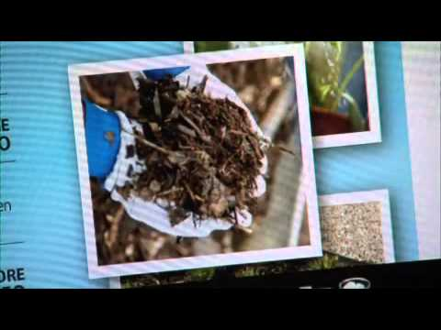
We will analyse Western Australia's management of water.
Humans change the natural movement of water in the water cycle to benefit how we live.
We use water in our households, gardens, in industry to make materials and farming to grow crops and food.
What water issues are we having in Perth from this video?

Slide 24
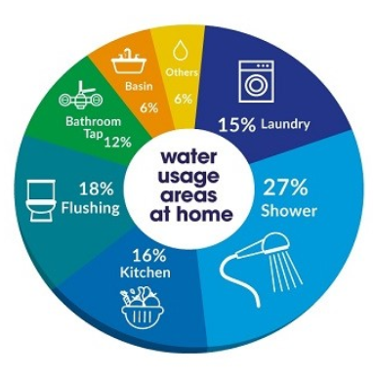
We will analyse Western Australia's management of water.
People in Perth use too much water per person. On average we use 33 liters a day. You might not think you use much water but the following diagram shows household and garden water usage.
CHECK FOR UNDERSTANDING
What activities could people in Perth change to reduce water use on a daily basis?
Bathroom
Toilet 15 L
5 minute shower: 45 L
Brushing teeth 27 L
Garden
Water plants 13 L
Sprinklers 750 L
Pool 70 L
Kitchen
Dishes: 10 L
Cooking: 5 L
Dishwashing: 40 L
Drinking 8 L
Notes:
http://www.bom.gov.au/water/waterinaustralia/files/Water-in-Australia-2016-17.pdf

Slide 25
We will analyse Western Australia's management of water.
There are 2 million people that live in Perth. As our population increases, so does the amount of houses and our use of water.
Climate change has caused a reduction in rainfall for Perth. The red areas show the lowest amount of rainfall in Spring 2016 and Winter 2017. Western Australia has experienced the lowest rainfall rate since 1911.
CHECK FOR UNDERSTANDING
What will be a problem if Perth’s population continues to increase and rainfall is decreasing?
EXTENSION
Increased Spring rainfall in the rest of Australia has led to flooding in lower lying areas of NSW.

Slide 26
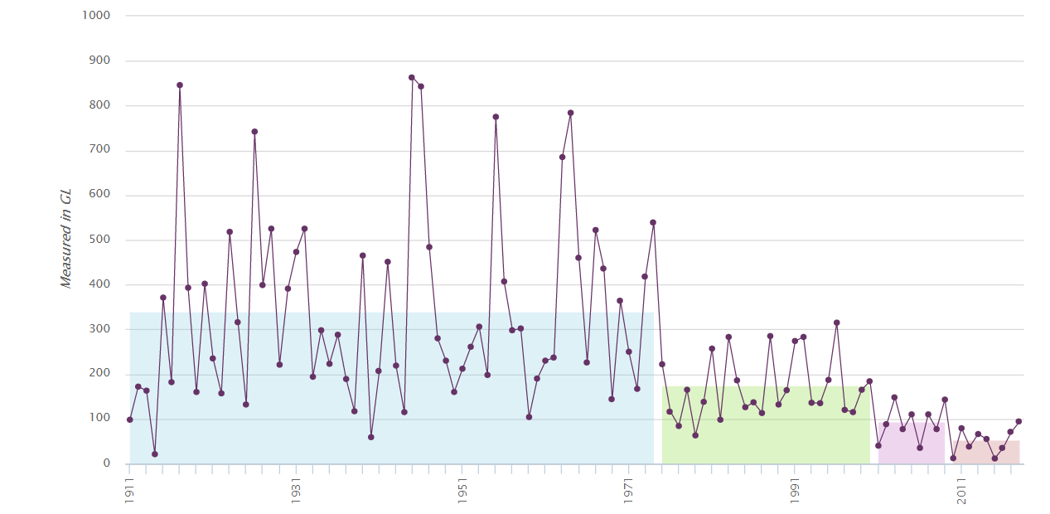
We will analyse Western Australia's management of water.
CHECK FOR UNDERSTANDING
Describe what is happening to the water cycle in reference to water collection, runoff and groundwater.
As rainfall decreases, runoff and groundwater collection has significantly decreased. This has impacted the supply of water to the Western Australian population.
This has impacted water availability to plants through groundwater and animals that access surface water in rivers and lakes.
EXTENSION
This graph shows the decrease in water run off that collects in dams each year. The spike is Winter rainfall.

Slide 27
We will analyse Western Australia's management of water.
CHECK FOR UNDERSTANDING
What is the impact on groundwater if we all save water.
Some activities use lots of water but we can save water with a few changes in practices.
Area of water use | Water wasting practice | Water saving practice
Farming | - High amount of sprinkler use - Grow crops that need lots of water - Crops for beef farming | -Drip sprinklers into plants roots - Grow plants that need less water - Crop rotation - Diet change, vegan or vegetarian
Garden | - Gardens with lots of lawn to water - Having a pool evaporates water - Sprinklers being used too often - Sprinklers on during the day | -Use compost and mulch to cover soil to reduce evaporation -Water at night -Sprinkler bans -Plant native plants that use less water - water tank to collect rainwater
Land management | - Growing pine trees in a plantations that use lots of groundwater - Concrete roads that change runoff | -Grow plants that use less water to supply resources such as bamboo - planning to include natural plants for runoff

Slide 28
We will analyse Western Australia's management of water.
Create a T chart comparing water wasting practices and water saving practices for the garden.
Research water wasting and saving practices in the household.
Water wasting practices
Water saving practices
Garden
HINT
Area of water use | Water wasting practice | Water saving practice
Farming | High amount of sprinkler use. | Drip sprinklers into plant roots.
Garden | Gardens with lots of lawn | Use compost and mulch
Land management | Growing pine trees | Grow plants that use less water to supply
Household
Notes:
Please include tasks/questions here rather than just referring to a worksheet. This will save on photocopying and facilitate sharing with other schools.
Try and build tasks/questions which escalate through Bloom’s Taxonomy. This will help with differentiation.

Slide 29
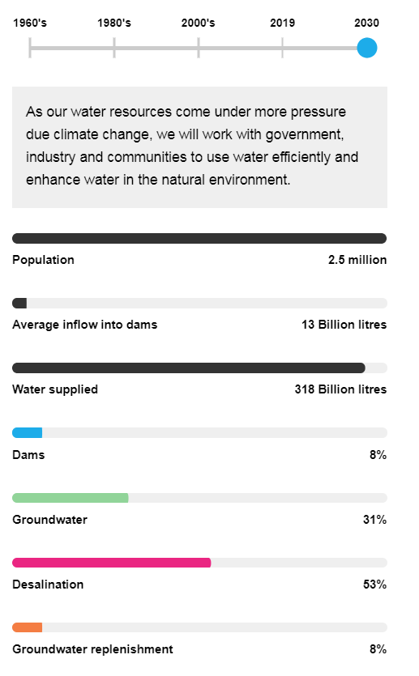
We will analyse Western Australia's management of water.
CHECK FOR UNDERSTANDING
VOCABULARY

